Slide 1
A Class-Agnostic Object Counting
Qian Kun
Yang Guang
Li Qiran

Slide 2

Agenda
Intro
Methodology
Experiments
Result and analysis
Conclusion and future work

Slide 3
Intro
Class-Agnostic Counting (CAC) is a computer vision task that counts instances from unseen classes via few-shot ex-emplars. It is a shift from class-specific counting tasks to generalized object counting in computer vision, handling the limitations of supervised methods requiring extensive labeled data per category.
Most popular works emphasize the two primary paradigms in few-shot CAC tasks: density map-based and detection-based methods.

Slide 4

Methodology

Slide 5
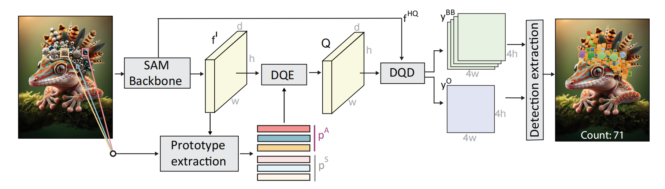
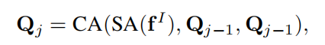
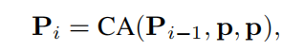
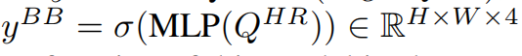
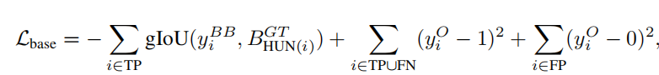
GeCo
DQE
DQD
LOSS:

Slide 6
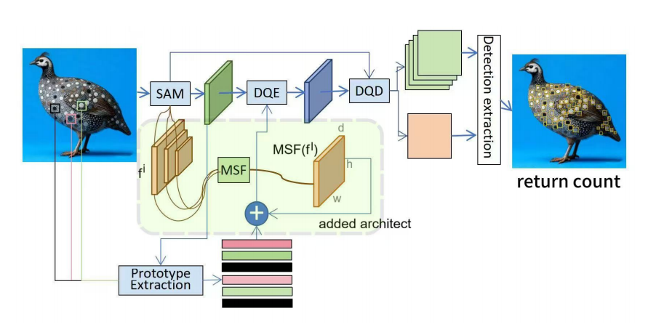
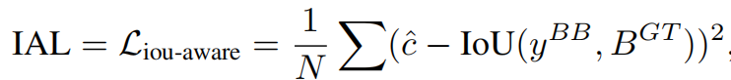
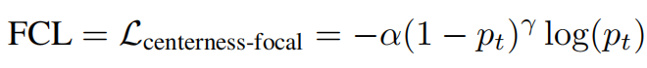
Improvements and redesigns
2 candidate redesigns：
reconstructing a sub-model with prototype iteration formula
adding 2 loss functions to the total: IoU Aware Loss (IAL) and Focal Centering Loss(FCL)

Slide 7

Experiments

Slide 8
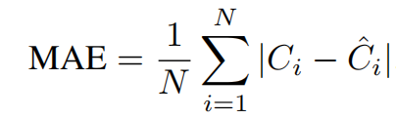
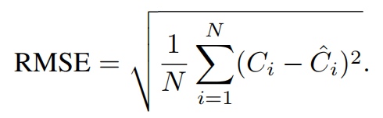
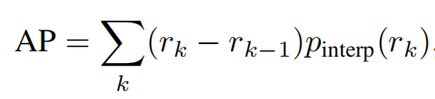
Dataset and metrics
Global Count Estimation Metrics :
Mean Absolute Error (MAE)
Root Mean Square Error (RMSE)
Average Precision (AP)
AP50
We evaluate our baseline on the FSCD-147 dataset. It provides bounding box annotations for all objects across 6,135 images spanning 147 diverse categories. This dataset enables comprehensive assessment of low-shot counting methods, with splits into training (3,659 images), validation (1,286 images), and test (1,190 images) sets. Our replicated experiments emphasize the few-shot setting as original. We use 3 exemplars per target category to predict object counts and locations.

Slide 9

Train strategies
Due to computer limitation, our replication of the model undergoes merely the evaluating stage though validation and test set, using original trained GeCo. And our redesign contains finetuning 30 epochs with a batch size of 4 on the training set before reevaluating.

Slide 10
Result and analysis

Slide 11
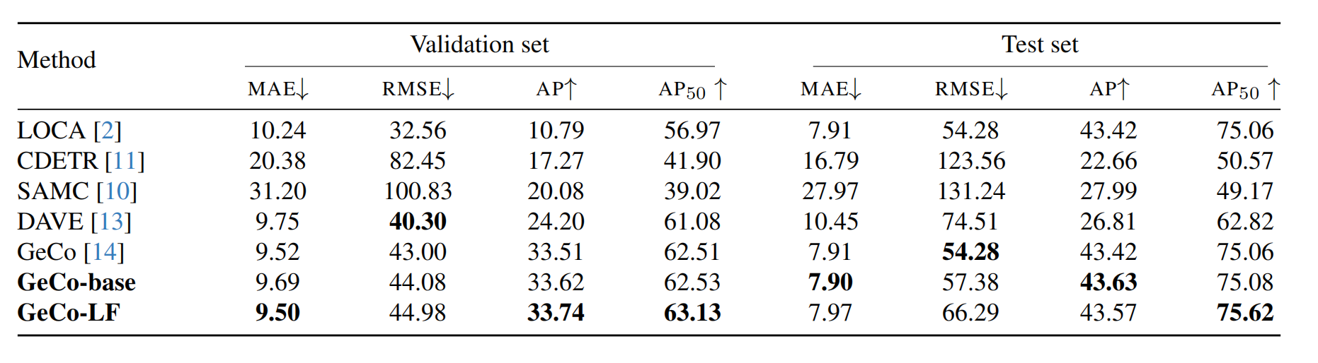
Comparison and analysis
Baseline replication(GeCo-base)：
The results align closely with the original metrics, with only marginal differences such as RMSE attributable to random seeds.
Redesigned model(GeCo-LF)：
GeCo-LF has nuanced metric variations compared to the baseline.

Slide 12
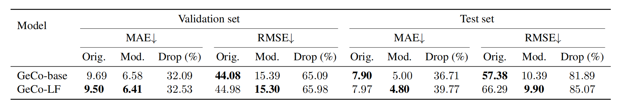
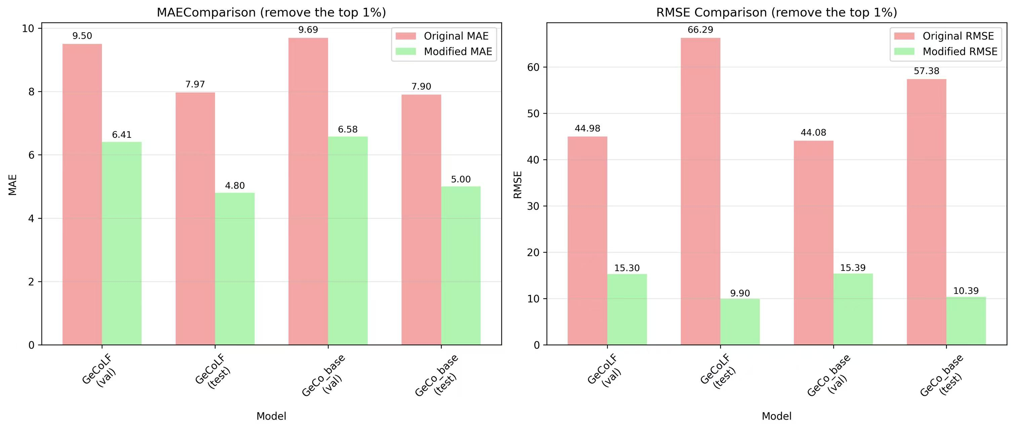
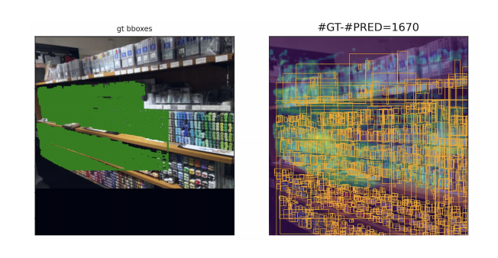
Investigation of Outliers

Slide 13
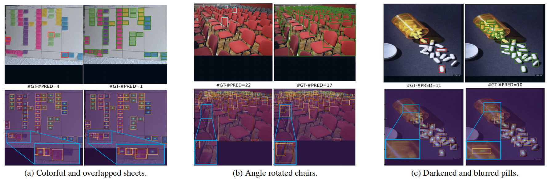
Samples with visualization

Slide 14
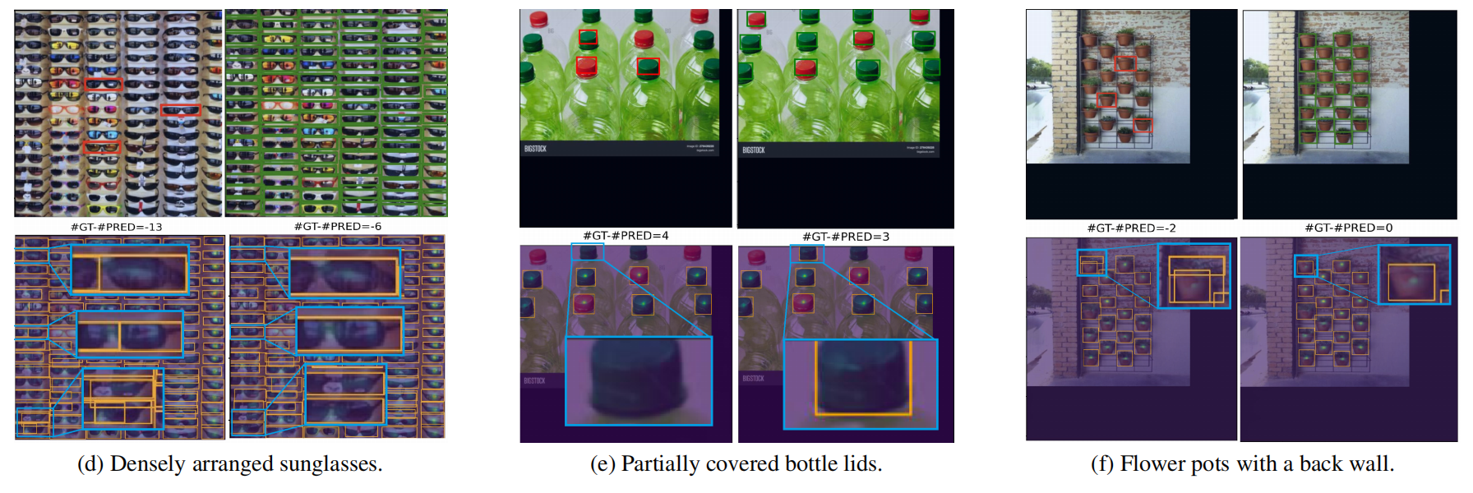
Samples with visualization

Slide 15
Conclusion and future work
We proposed a redesigned CAC system based on GeCo and two losses to optimize counting predictions. On FSCD-147 validation set, our model makes marginal improvements in the metrics of MAE and AP, though test RMSE rises due to outlier sensitivity. Our quantified analyses across diverse scenarios show reduced miscounts, using our visualization for explainable outputs.
In the future, researchers of CAC would probably focus on training-free paradigms, dynamic example network to address the appearance rarity in CAC task, and structured attention mechanism of modern vision models. Also hybrid reference-less or text-guided methods fused with semantic segmentation, are proposed for complex, crowded environments.

Slide 16
Thanks for Your Listening! Q&A

